Slide 1
SUNSHINE LAW & PUBLIC RECORDS REQUESTS
NICOLE FERRIS Palm Beach County Public Affairs Media & Public Information

Slide 2
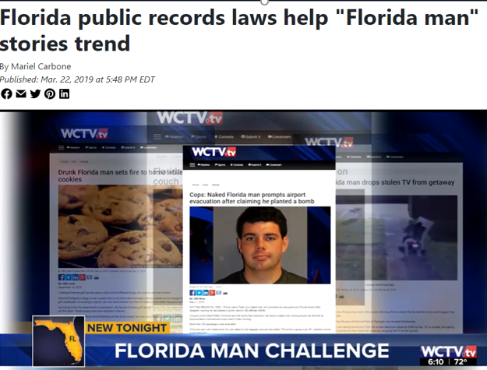
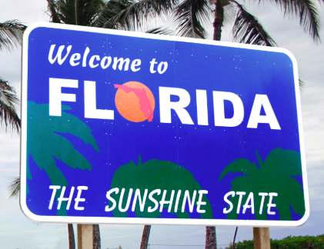
WHAT THE FLORIDA?!
MOST EXPANSIVE OPEN GOVERNMENT LAWS IN THE COUNTRY

Slide 3
Public Records Law / Chapter 119
Passed in 1909
Any records made or received by any public agency in the course of official business are public, unless specifically exempted
Sunshine Law
Enacted in 1967
Requires all meetings of any state, county, municipal board or commission be open to the public
Reasonable notice of meetings must be given

Slide 4
PUBLIC RECORDS REQUESTS
Anyone can request public records for any reason
Can remain anonymous
Does not have to be made in writing
Acknowledge requests promptly, produce records in a reasonable amount of time, No set “deadline”
Agency not required to create documents

Slide 5
COSTS PALM BEACH COUNTY POLICY
Based on the amount of staff time to retrieve and/or review records
First 30 minutes of each task no charge
Approval before work is done
Records provided once payment received

Slide 6
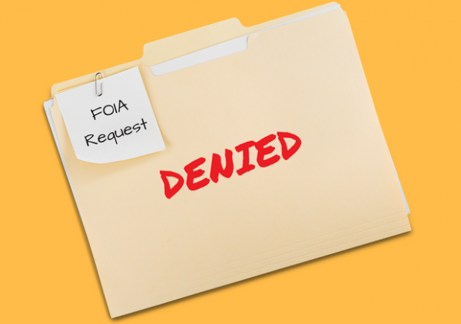
EXEMPTIONS
ALL PUBLIC RECORDS ARE SUBJECT TO DISCLOSURE UNLESS PUBLICLY EXEMPT
COMMON EXEMPTIONS:
Active Investigation, Litigation, Open Claims
Records Involving Public Security, Infrastructure
Addresses and Phone Numbers for Firefighters, Law Enforcement, Judges
Social Security Numbers, Driver License Numbers
Medical Information
Redact exempt information
Cite the statute Disclose the remainder of the public record

Slide 7
PHONE RECORDS
SUGGESTED POLICIES
Discouraging use of private accounts to send or receive public records
Transmit public records sent or received on private accounts to government accounts.
PENALTIES FOR NONCOMPLIANCE
Criminal penalties
Civil action
Attorney’s fees

Slide 8
RECORDS RETENTION
Most records have a retention period of 10 years or less.
Retention of records is based on the content of the record.
Certain records must be maintained permanently:
Master plans, Bond resolutions, Ordinances, Charters, Amendments, Bylaws, Constitutions, Annual reports, Annexation records

Slide 9
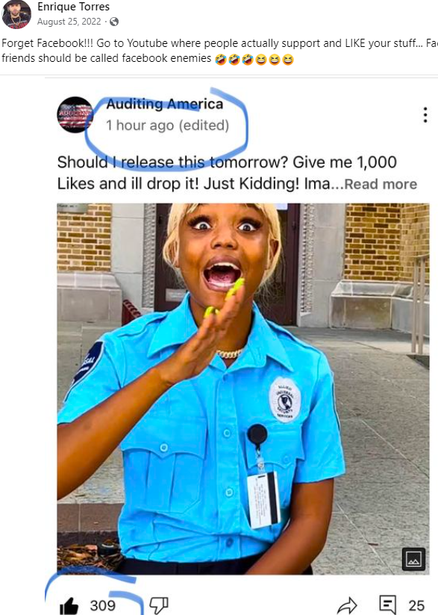
First Amendment Auditors

Slide 10
First Amendment Auditors
WIVB NEWS How First Amendment 'auditors' target public servants for viral videos – YouTube
Acura Amanda: WPB Police Why Are They Hiding These Records From The Public? - YouTube
TALLAHASSEE POST OFFICE (CRAZY)"DELETE YOUR VIDEO NOW!!! First Amendment Audit (EPIC FAIL) - YouTube
POLK COUNTY TAX COLLECTOR Crazy: "YOURE GOING TO JAIL!!! "DELETE YOUR VIDEO NOW!!! Polk County Florida – YouTube
TEASDALE, STATE OFFICE BLDG: (Must See) I ESCAPED from this OFFICER!!! "YOURE DETAINED" First Amendment Audit FAIL - YouTube

Slide 11
POP QUIZ!
A requestor must identify themselves to submit a request

Slide 12
POP QUIZ!
A requestor must identify themselves to submit a request
FALSE

Slide 13
POP QUIZ!
A requestor must identify themselves to submit a request
FALSE
The request must be made in writing

Slide 14
POP QUIZ!
A requestor must identify themselves to submit a request
FALSE
The request must be made in writing FALSE

Slide 15
POP QUIZ!
A requestor must identify themselves to submit a request
FALSE
The request must be made in writing FALSE
Business records on a personal computer or phone aren’t public records

Slide 16
POP QUIZ!
A requestor must identify themselves to submit a request
FALSE
The request must be made in writing FALSE
Business records on a personal computer or phone aren’t public records FALSE

Slide 17
POP QUIZ!
A requestor must identify themselves to submit a request
FALSE
The request must be made in writing FALSE
Business records on a personal computer or phone aren’t public records FALSE
Requests must be completed in 30 days

Slide 18
POP QUIZ!
A requestor must identify themselves to submit a request
FALSE
The request must be made in writing FALSE
Business records on a personal computer or phone aren’t public records FALSE
Requests must be completed in 30 days
FALSE

Slide 19
THANK YOU!
QUESTIONS?

